Slide 1
Coursera Capstone Project - The Battle of Neighborhoods
A Restaurant Recommendation System in North York, Canada
14/05/19

Slide 2
1
Introduction
CONTENTS
2
Data Review
3
Methodology
4
Results
5
Discussion
6
References

Slide 3

1. The project is aimed at providing recommendations about the location and cuisine
2. The recommendation system is built on Foursquare dataset, geographical data of North York from the internet.

Slide 4

1. The dataset used in this project is mainly from Wikipedia, including postcodes and neighborhoods information, and the geographical information
2. The recommendation system is built on Foursquare dataset, geographical data of North York from the internet.

Slide 5


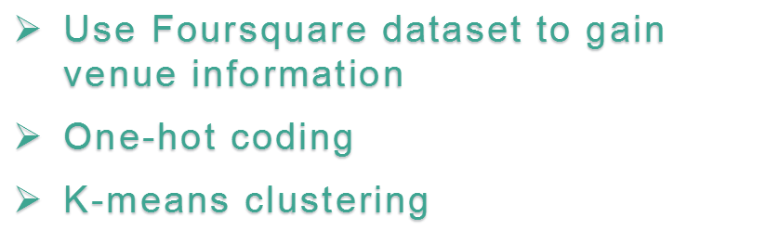

Slide 6

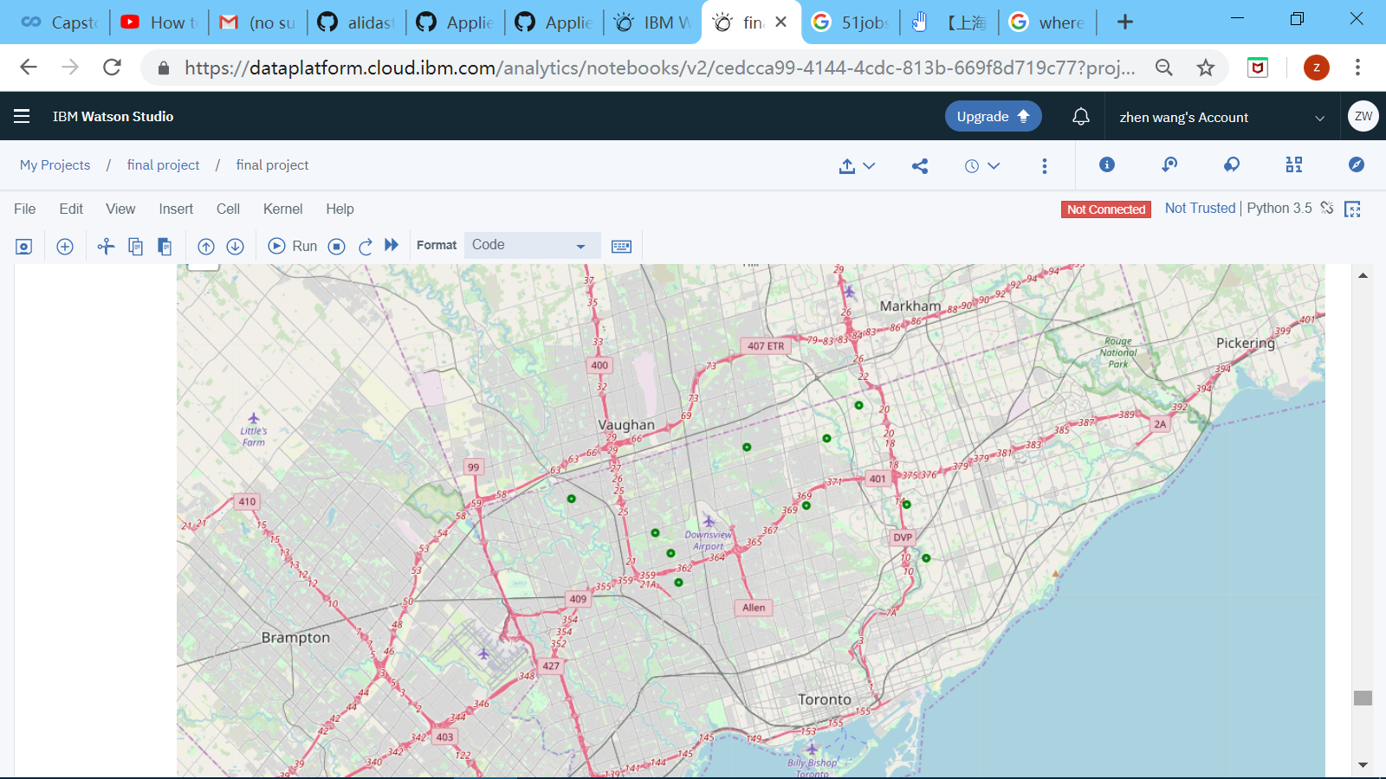

Slide 7
In Bayview Village, most popular restaurants are:
1. Asian restaurants (Chinese & Japan)
2. fast-food restaurants
3. European restaurants (Eastern European & Middle European).

Slide 8



Slide 9
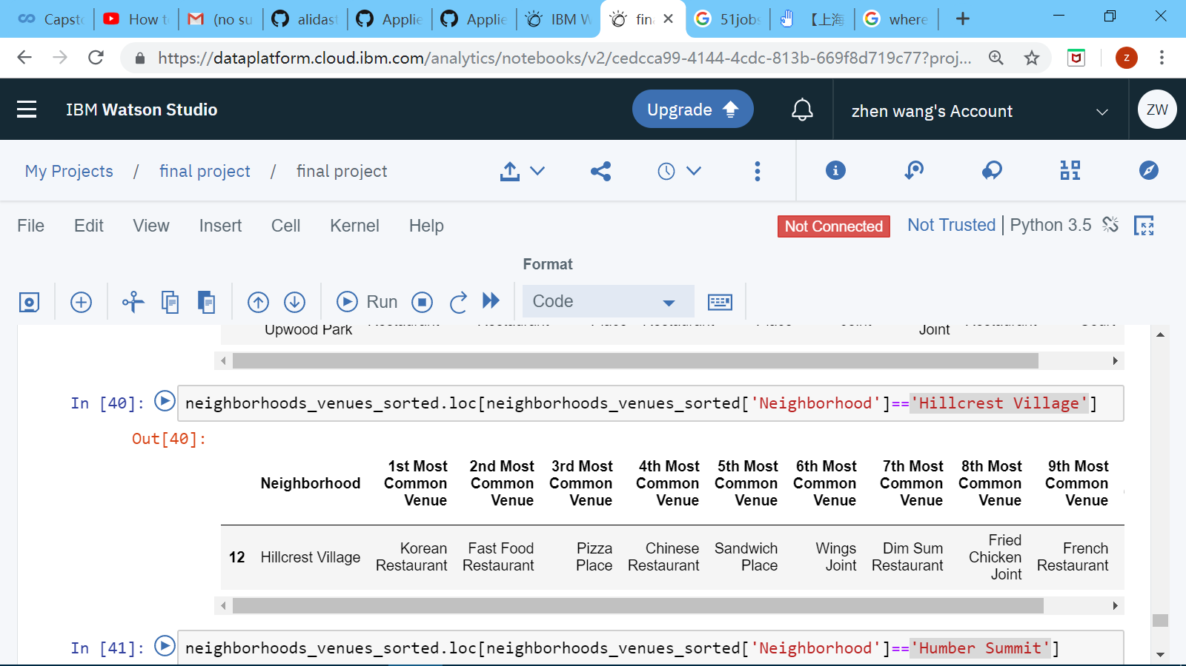
For instance, opening a restaurant specialized in Asian cuisines or fast food might be the first option in Hillcrest Village.

Slide 10


1.https://en.wikipedia.org/wiki/North_York
2.https://en.wikipedia.org/wiki/List_of_postal_codes_of_Canada:_M

